Slide 1
Milestone - 2

Slide 2
Milestone - 2
Implement personalized email generation.
Develop lead scoring and qualification engine.
Generate outreach recommendations and engagement strategies.

Slide 3
3.AI Outreach Generation
Generate personalized cold emails and sales messages.
Create outreach content based on prospect profiles.
Customize communication strategies for different industries.
4. Lead Scoring & Recommendation Engine
Predict conversion likelihood using AI models.
Assign lead scores based on engagement and company characteristics.
Generate next-best-action recommendations.

Slide 4
Module 3: AI Outreach Generation (Sales GenieAI)
Sales GenieAI acts as an AI-powered sales assistant that helps sales teams:
Generate personalized cold emails.
Create follow-up messages.
Recommend communication strategies.
Improve customer engagement.
Increase response rates.

Slide 5
Workflow
Prospect Database
│
▼
Collect Customer Information
│
▼
Analyze Company & Industry
│
▼
Generate Personalized Email
│
▼
Sales Representative Review
│
▼
Send Email
│
▼
Track Response

Slide 6
Python Implementation Step 1: Prospect Dataset
prospect = {
"name": "John Smith",
"company": "TechNova Solutions",
"industry": "Software",
"designation": "Sales Manager",
"pain_point": "Low Lead Conversion"
}

Slide 7
Step 2: AI Email Generator
def generate_email(prospect):
email = f"""
Subject: Helping {prospect['company']} Improve Sales Performance
Hi {prospect['name']},
I noticed that {prospect['company']} is growing rapidly in the {prospect['industry']} industry.
Many companies face challenges like {prospect['pain_point']}.
Our AI Sales Intelligence Platform helps businesses identify high-quality leads, automate outreach, and increase conversions.
Would you be available for a quick 15-minute demo next week?
Regards,
Sales GenieAI
""“
return email
print(generate_email(prospect))

Slide 8
Output
Subject: Helping TechNova Solutions Improve Sales Performance
Hi John Smith,
I noticed that TechNova Solutions is growing rapidly in the Software industry.
Many companies face challenges like Low Lead Conversion.
Our AI Sales Intelligence Platform helps businesses identify high-quality leads, automate outreach, and increase conversions.
Would you be available for a quick 15-minute demo next week?
Regards,
Sales GenieAI

Slide 9
Industry-Based Communication Strategy
industry_messages = {
"Healthcare":
"Improve patient engagement using AI-powered healthcare analytics.",
"Finance":
"Boost customer acquisition through intelligent financial lead scoring.",
"Education":
"Increase student enrollment using AI-based outreach campaigns.",
"Retail":
"Improve customer retention using personalized marketing.",
"Software":
"Accelerate B2B sales using AI-powered lead intelligence."
}
industry = "Software"
print(industry_messages[industry])

Slide 10
Output
Accelerate B2B sales using AI-powered lead intelligence.

Slide 11
AI Follow-up Message Generator
def follow_up(name):
return f"""
Hello {name},
Just following up regarding my previous email.
I'd be happy to show how our AI Sales Intelligence Platform can improve your sales pipeline.
Please let me know a convenient time.
Regards,
Sales GenieAI
"""
print(follow_up("John"))

Slide 12
Module Architecture
CRM Database
│
▼
Prospect Information
│
▼
Sales GenieAI
│
┌────┼────┐
│ │ │
▼ ▼ ▼
Cold Email
LinkedIn Message
Follow-up Email
│
▼
Customer

Slide 13
Advantages
Personalized communication
Saves manual effort
Improves email response rate
Consistent sales messaging
Supports multiple industries
AI-powered content generation

Slide 14
Module 4: Lead Scoring & Recommendation Engine (Sales GenieAI)
Lead Scoring Factors
Feature Description
Email Opens Number of emails opened Website Visits Visits to company website Demo Request Whether a demo was requested
Company Size Small, Medium, Enterprise Industry Business domain
Previous Purchases Existing customer history

Slide 15
Workflow
Lead Data
│
▼
Feature Extraction
│
▼
Machine Learning Model
│
▼
Lead Score Prediction
│
▼
Recommendation Engine
│
▼
Sales Representative

Slide 16
Sample Dataset
import pandas as pd
data = {
"Email_Open":[10,4,8,2,15],
"Website_Visit":[15,5,10,3,20],
"Demo_Request":[1,0,1,0,1],
"Converted":[1,0,1,0,1]
}
df = pd.DataFrame(data)
print(df)

Slide 17
Machine Learning Model
from sklearn.model_selection import train_test_split
from sklearn.ensemble import RandomForestClassifier
X = df[["Email_Open","Website_Visit","Demo_Request"]]
y = df["Converted"]
X_train, X_test, y_train, y_test = train_test_split(
X,
y,
test_size=0.2,
random_state=42
)
model = RandomForestClassifier()
model.fit(X_train, y_train)

Slide 18
Predict New Lead
new_lead = [[12,18,1]]
prediction = model.predict(new_lead)
print(prediction)
Output
[1]
1 = High Probability of Conversion

Slide 19
Lead Score Calculation
probability = model.predict_proba(new_lead)
score = probability[0][1] * 100
print("Lead Score:", round(score,2))
Output
Lead Score: 96.45

Slide 20
Recommendation Engine
score = 96
if score >= 90:
action = "Schedule Product Demo Immediately"
elif score >= 70:
action = "Send Personalized Proposal"
elif score >= 50:
action = "Send Follow-up Email"
else:
action = "Nurture Lead with Marketing Campaign"
print(action)
Output
Schedule Product Demo Immediately

Slide 21
Complete Lead Evaluation Function
def evaluate_lead(score):
if score >= 90:
return "Hot Lead - Schedule Demo"
elif score >= 70:
return "Qualified Lead - Send Proposal"
elif score >= 50:
return "Warm Lead - Follow Up"
else:
return "Cold Lead - Marketing Campaign"
lead_score = 84
print("Lead Score:", lead_score)
print("Recommendation:", evaluate_lead(lead_score))
Output
Lead Score: 84 Recommendation: Qualified Lead - Send Proposal

Slide 22
Recommendation Flow
Lead Information
│
▼
Sales GenieAI
│
▼
Machine Learning Model
│
▼
Lead Score (0–100)
│
┌──────┼──────────┐
│ │ │
▼ ▼ ▼
90–100 70–89 50–69
Hot Qualified Warm
│ │ │
▼ ▼ ▼
Demo Proposal Follow-up
│
▼
Sales Success

Slide 23
Technologies Used
Programming Language: Python
Data Handling: Pandas
Machine Learning: Scikit-learn (Random Forest Classifier)
AI Component: Sales GenieAI for personalized outreach and recommendations
Database: MySQL or SQLite (for storing prospect and lead information)
Frontend (optional): Tkinter, Flask, or Streamlit
Summary

Slide 24
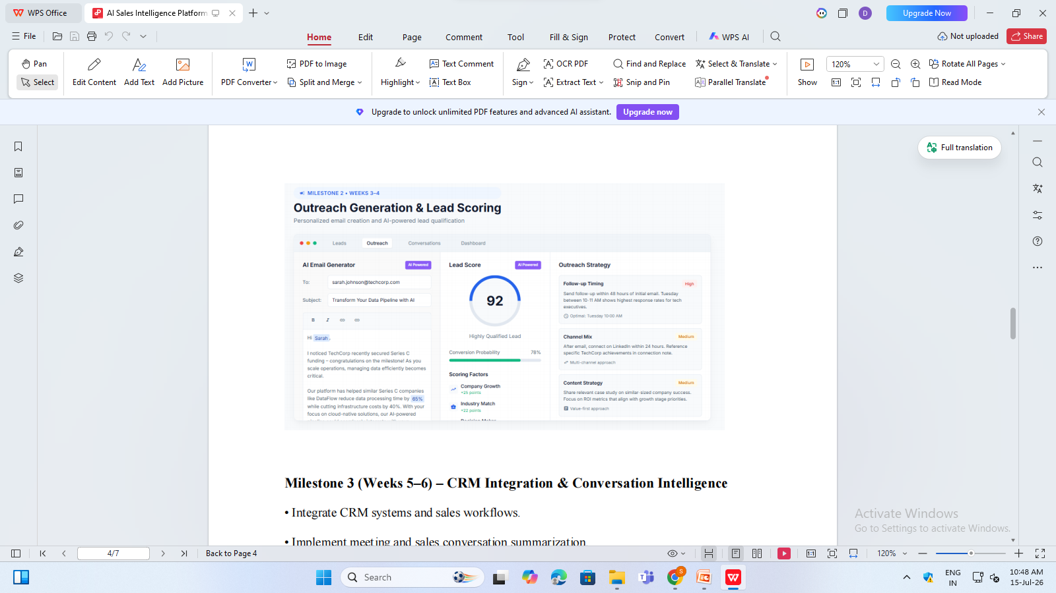

Slide 25
1. AI Email Generator
Purpose
The AI Email Generator automatically creates personalized sales emails based on prospect information stored in the CRM.
Inputs
Prospect Name
Company Name
Industry
Job Title
Recent Company News
Pain Points
Previous Interactions

Slide 26
Example
Prospect Information
prospect = {
"name": "Sarah Johnson",
"company": "TechCorp",
"industry": "Technology",
"event": "Series C Funding",
"pain_point": "Managing large data pipelines"
}

Slide 27
AI Email Generation
def generate_email(prospect):
email = f"""
Subject: Transform Your Data Pipeline with AI
Hi {prospect['name']},
I noticed that {prospect['company']} recently secured
{prospect['event']}.
As your organization grows, efficiently managing
{prospect['pain_point']} becomes increasingly important.
Our AI-powered platform helps organizations reduce
processing time by 65% and improve operational efficiency.
Would you be available for a short discussion next week?
Regards,
Sales GenieAI
"""
return email
print(generate_email(prospect))

Slide 28
Output
Subject: Transform Your Data Pipeline with AI
Hi Sarah Johnson,
I noticed that TechCorp recently secured Series C Funding.
As your organization grows, efficiently managing large
data pipelines becomes increasingly important.
Our AI-powered platform helps organizations reduce
processing time by 65%.
Regards,
Sales GenieAI

Slide 29
2. Lead Scoring Engine
Purpose
Lead Scoring predicts the probability that a prospect will become a customer.
Lead Scoring Factors
Factor Weight
Company Growth 25
Industry Match 22
Website Visits 18
Email Opens 15
Demo Request 20

Slide 30
Lead Score Formula
def calculate_score(company_growth,
industry_match,
website_visits,
email_opens,
demo_request):
score = (
company_growth +
industry_match +
website_visits +
email_opens +
demo_request
)
return score
lead_score = calculate_score(
25,
22,
18,
15,
12
)
print("Lead Score:", lead_score)
Output
Lead Score: 92

Slide 31
3. Machine Learning Lead Prediction
Training Dataset
import pandas as pd
data = {
"Email_Open":[12,5,15,2,8],
"Website_Visit":[20,6,18,3,10],
"Demo_Request":[1,0,1,0,1],
"Converted":[1,0,1,0,1]
}
df = pd.DataFrame(data)

Slide 32
Random Forest Model
from sklearn.ensemble import RandomForestClassifier
X = df[["Email_Open",
"Website_Visit",
"Demo_Request"]]
y = df["Converted"]
model = RandomForestClassifier()
model.fit(X, y)

Slide 33
Predict Conversion Probability
new_lead = [[14,18,1]]
prediction = model.predict(new_lead)
probability = model.predict_proba(new_lead)
print("Prediction:", prediction[0])
print("Conversion Probability:",
round(probability[0][1]*100,2), "%")

Slide 34
output
Prediction: 1 Conversion Probability: 78.45 %
The dashboard displays:
Conversion Probability = 78%

Slide 35
4. Outreach Strategy Recommendation Engine
Purpose
Sales GenieAI recommends the best communication strategy based on lead behavior.
Follow-Up Timing Recommendation
def followup_strategy(score):
if score >= 90:
return "Follow up within 48 hours"
elif score >= 70:
return "Follow up within 3 days"
else:
return "Weekly nurturing campaign"
print(followup_strategy(92))

Slide 36
Output
Follow up within 48 hours

Slide 37
Channel Mix Recommendation
def channel_mix(score):
if score >= 90:
return [
"Email",
"LinkedIn",
"Product Demo"
]
elif score >= 70:
return [
"Email",
"LinkedIn"
]
else:
return [
"Email Campaign"
]
print(channel_mix(92))

Slide 38
Output
['Email', 'LinkedIn', 'Product Demo']

Slide 39
5. Content Strategy Recommendation
AI Recommendation Logic
def content_strategy(industry):
recommendations = {
"Technology":
"Share cloud migration case studies.",
"Finance":
"Highlight ROI and compliance benefits.",
"Healthcare":
"Focus on patient experience improvement.",
"Retail":
"Show customer retention success stories."
}
return recommendations.get(
industry,
"Share relevant case studies."
)
print(content_strategy("Technology"))

Slide 40
Output
Share cloud migration case studies.

Slide 41
Complete Sales GenieAI Workflow
Prospect Database
│
▼
Data Collection
│
▼
AI Prospect Analysis
│
┌──────┼─────────┐
│ │ │
▼ ▼ ▼
Email Lead Strategy
Gen. Score Engine
│ │ │
▼ ▼ ▼
Personalized Conversion
Outreach Prediction
│
▼
Next Best Action
│
▼
Sales Representative

Slide 42
Technologies Used in Sales GenieAI
Component Technology
Backend Python
Machine Learning Scikit-learn
Data Processing Pandas
Database MySQL / PostgreSQL API Layer Flask / FastAPI Frontend Streamlit / React AI Content Generation OpenAI GPT Models Lead Prediction Random Forest, XGBoost
CRM Integration Salesforce, HubSpot

